Slide 1
Normalization of T21 Samples in DESeq2
By: Samuel Hunter

Slide 2
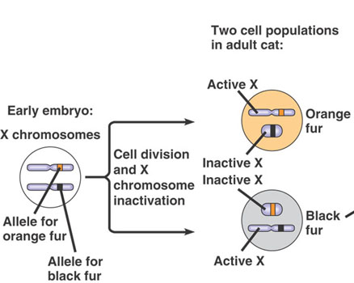
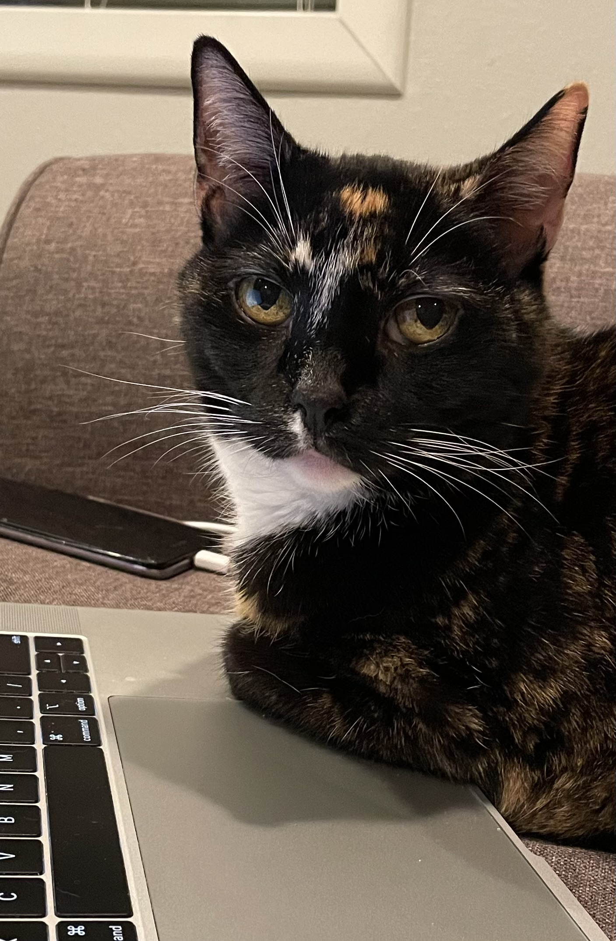
Canonical dosage compensation: X inactivation in female mammals
https://socratic.org/biology/genetics-inheritance/x-inactivation
Notes:
Good slide illustrating the confusion

Slide 3
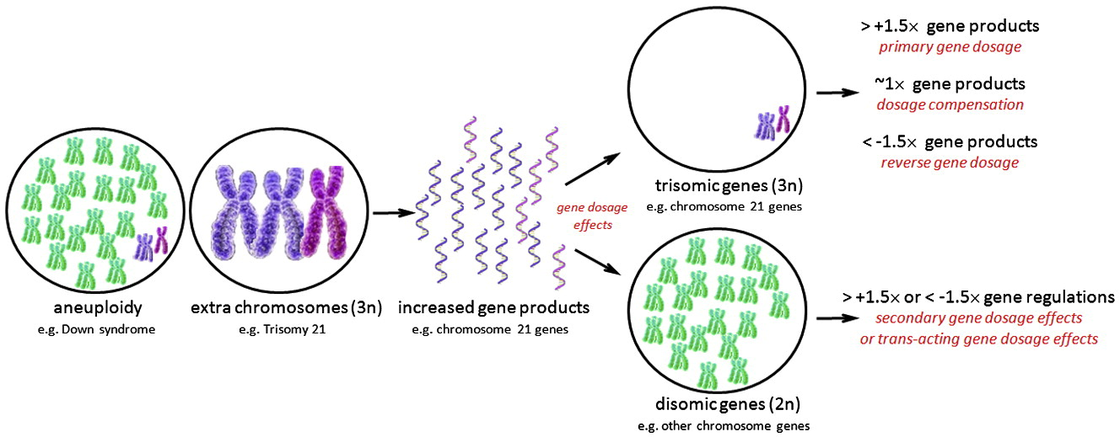
“Dosage compensation” in Down syndrome? Are there any genes which exhibit compensation?
Wang et al, 2011
Notes:
Good slide again, perhaps redundant

Slide 4
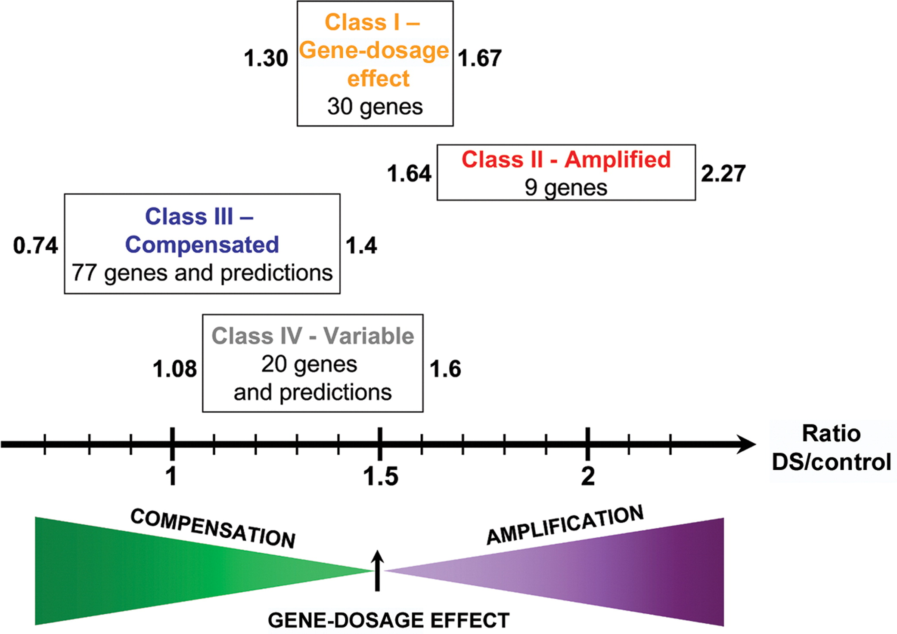
There is some conflict in the literature about whether dosage compensation occurs in trisomy 21
Yahya-Grayson et al, 2007
Notes:
Good summary slide illustrating the problem

Slide 5
So how would we use differential expression analysis to assess whether chr21 genes are exhibiting “compensation”?

Slide 6
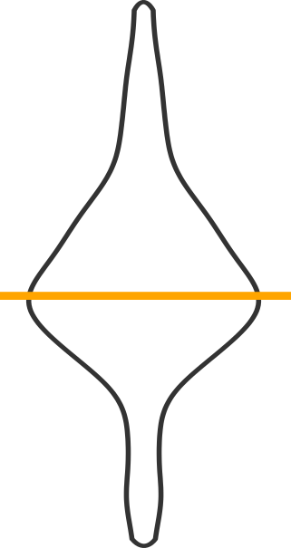
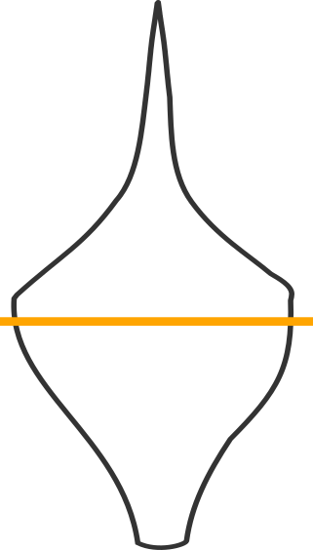
If any compensation were occurring, then the distribution of fold changes on chr21 should shift accordingly. We can use a significance test to see whether that shift is outside of expectation
1.5x
Some Chr21
are compensated
No Dosage
Compensation
Fold Change
1.0x
Non-chromosome 21 Genes
Chromosome 21 Genes

Slide 7
Exercise

Slide 8
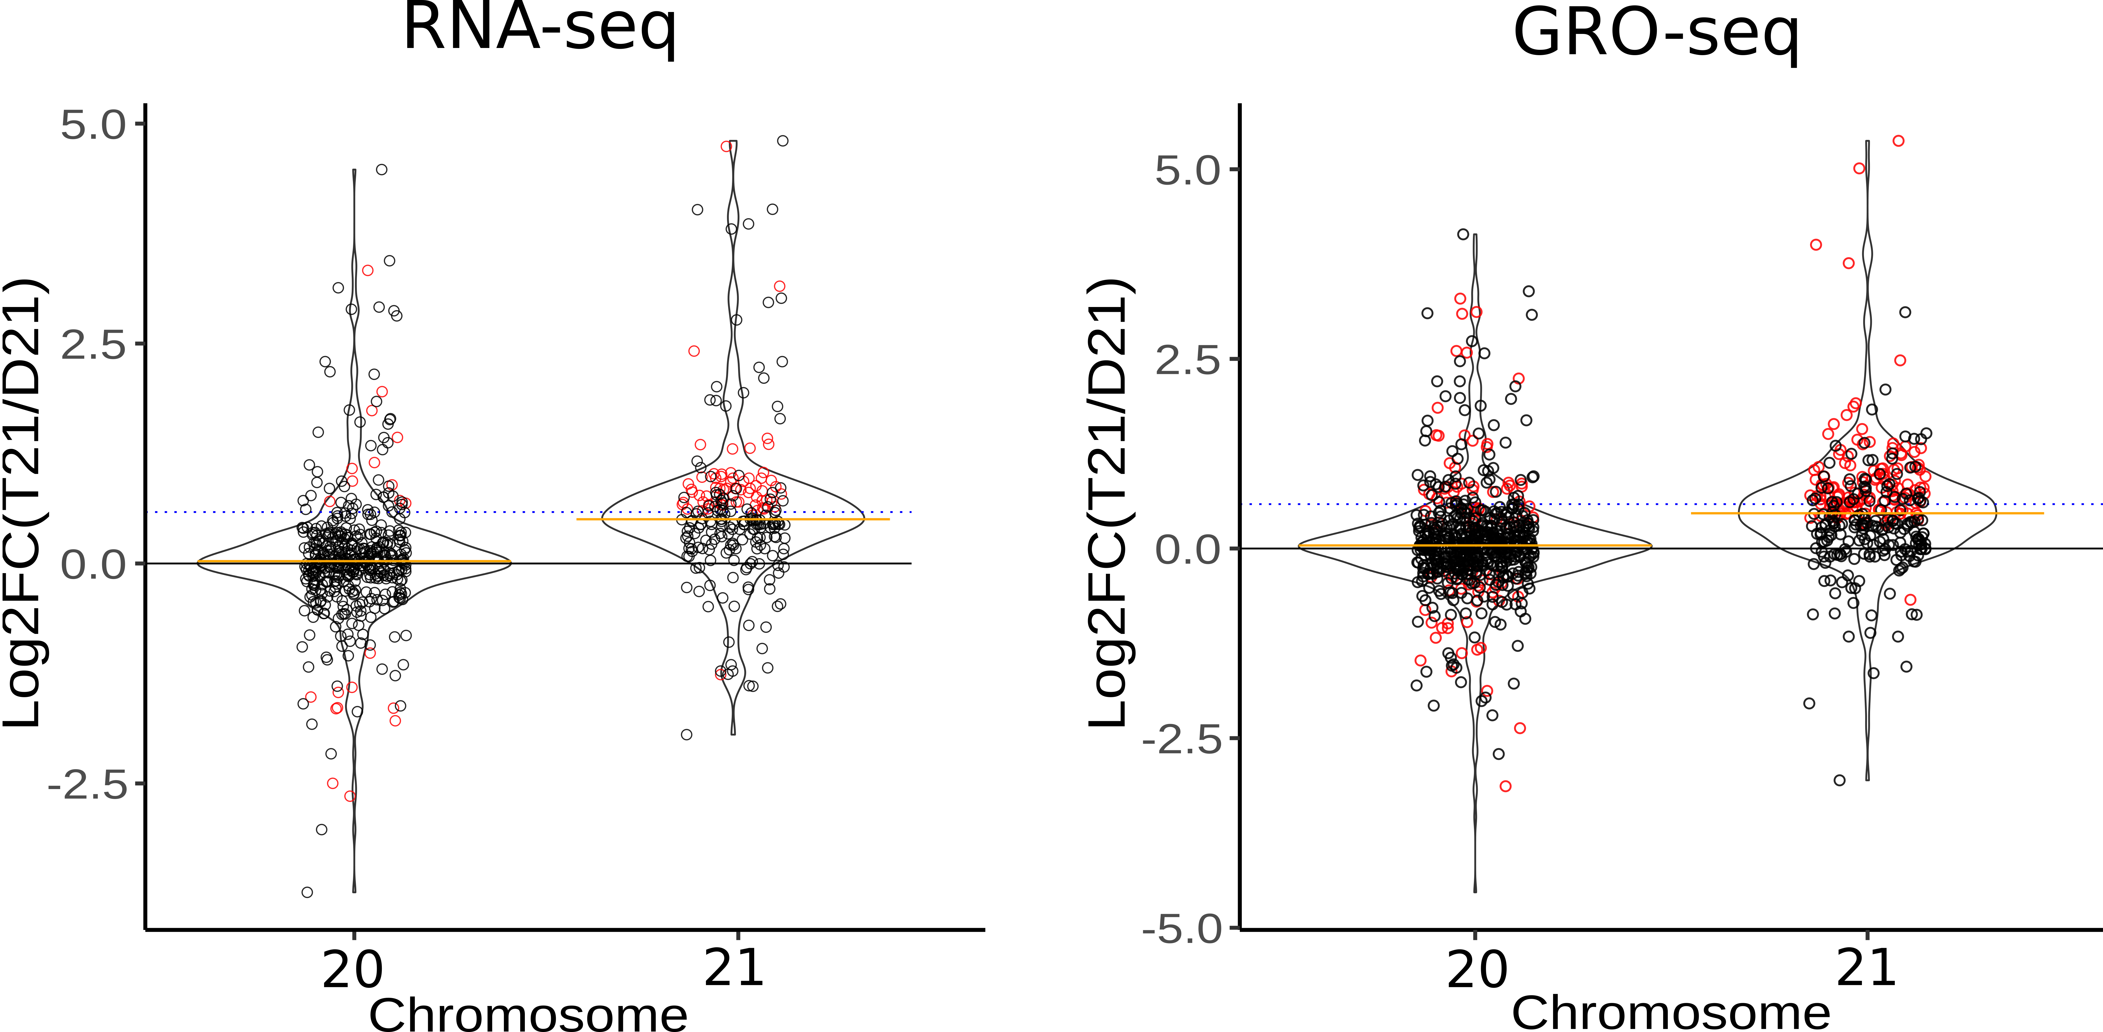
Naïve analysis: fold change are slightly below expectation. Some chr21 genes fall below a LFC of 0
Notes:
Basically just show the before/after for GRO-seq next to the pipeline. Say you did a bunch of things, and found only a handful of DC genes

Slide 9
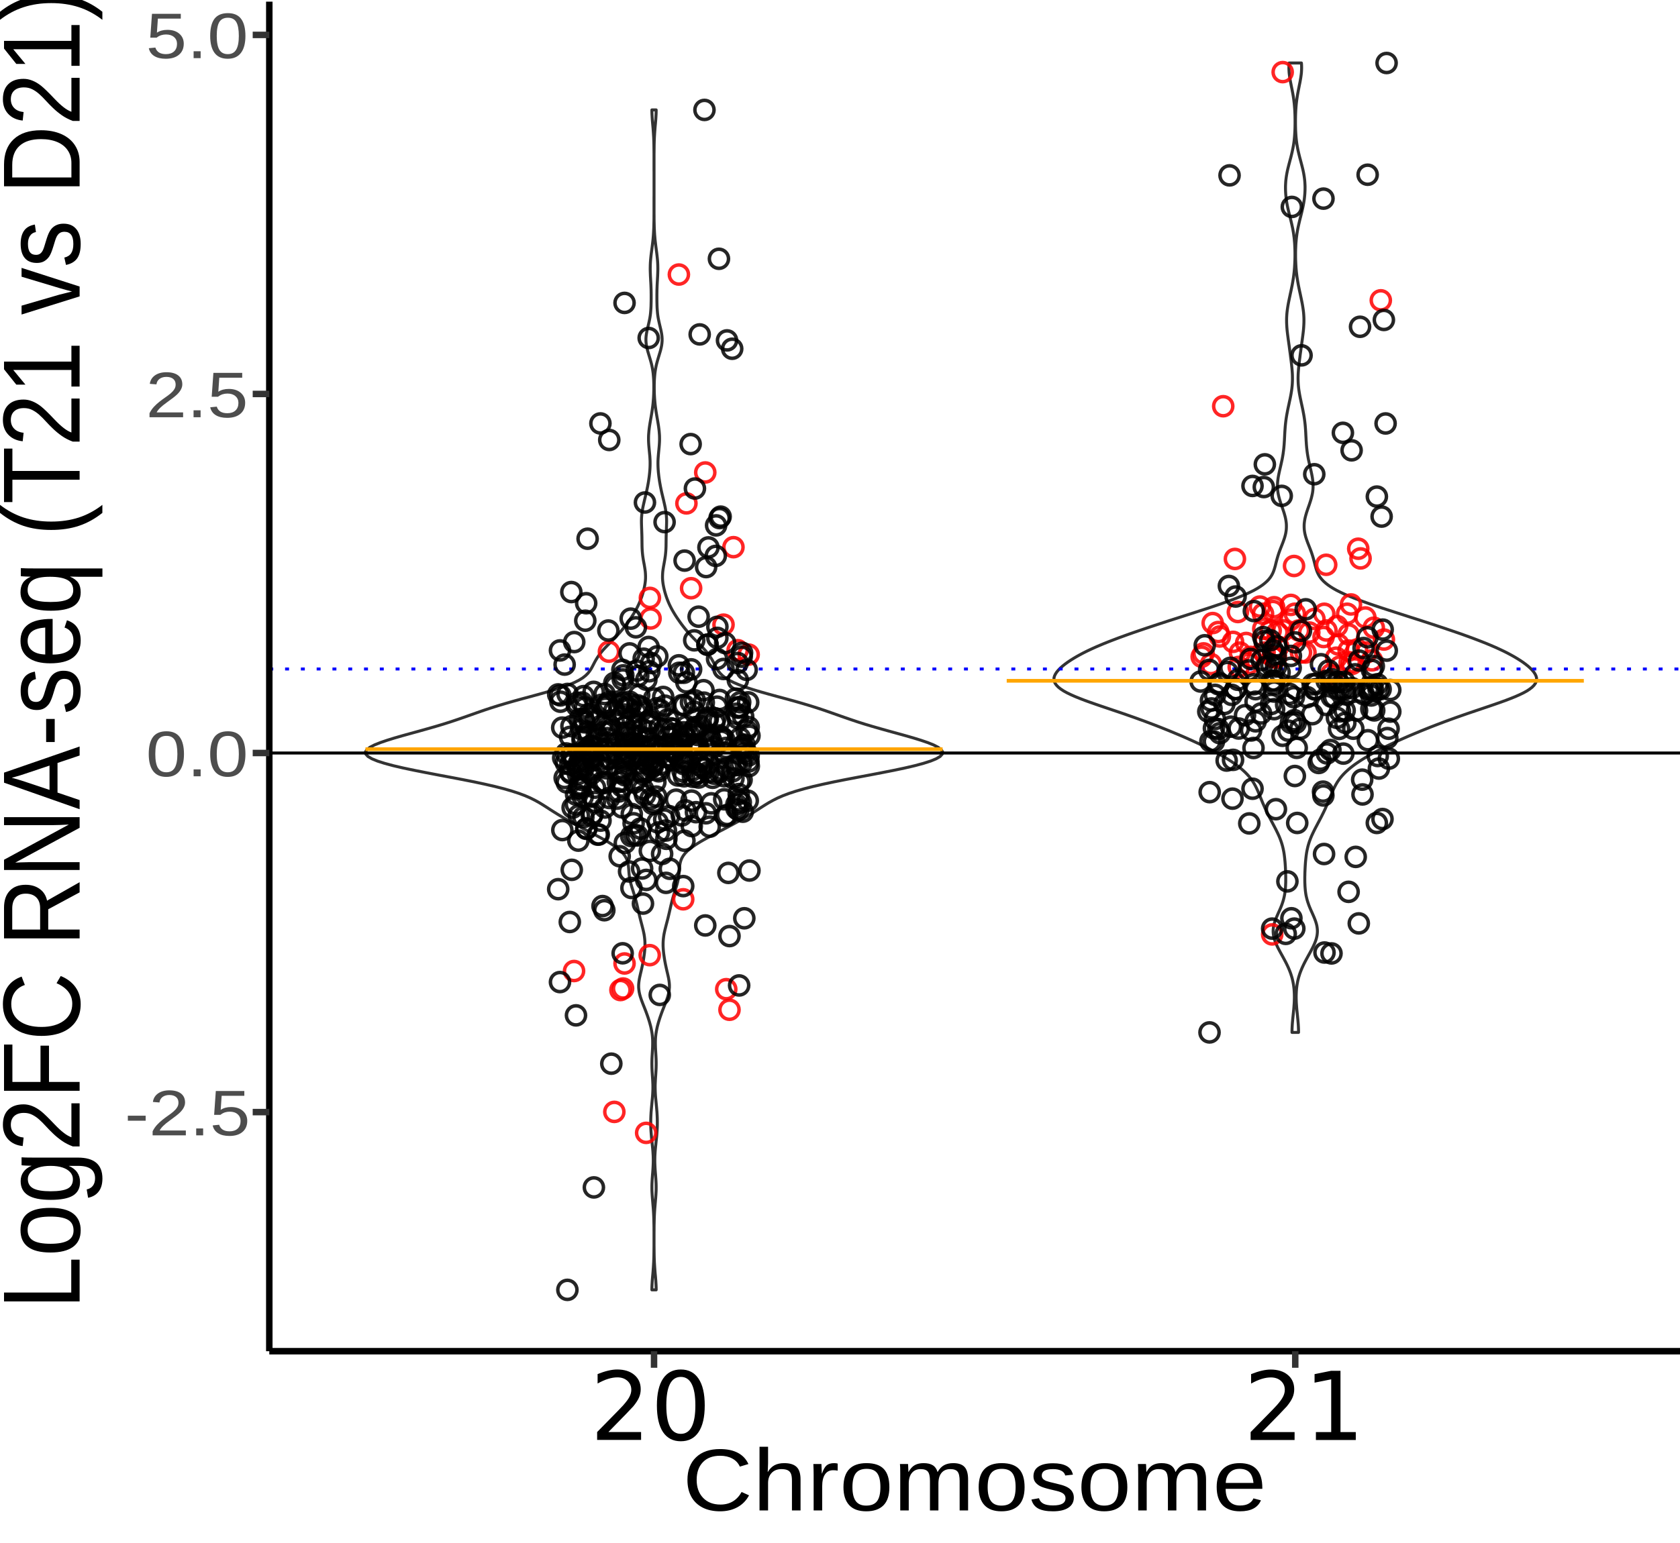
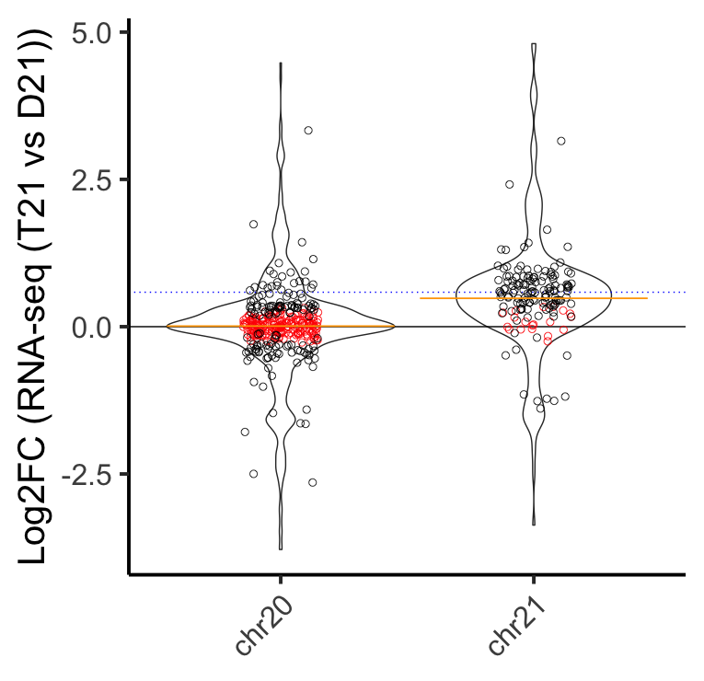
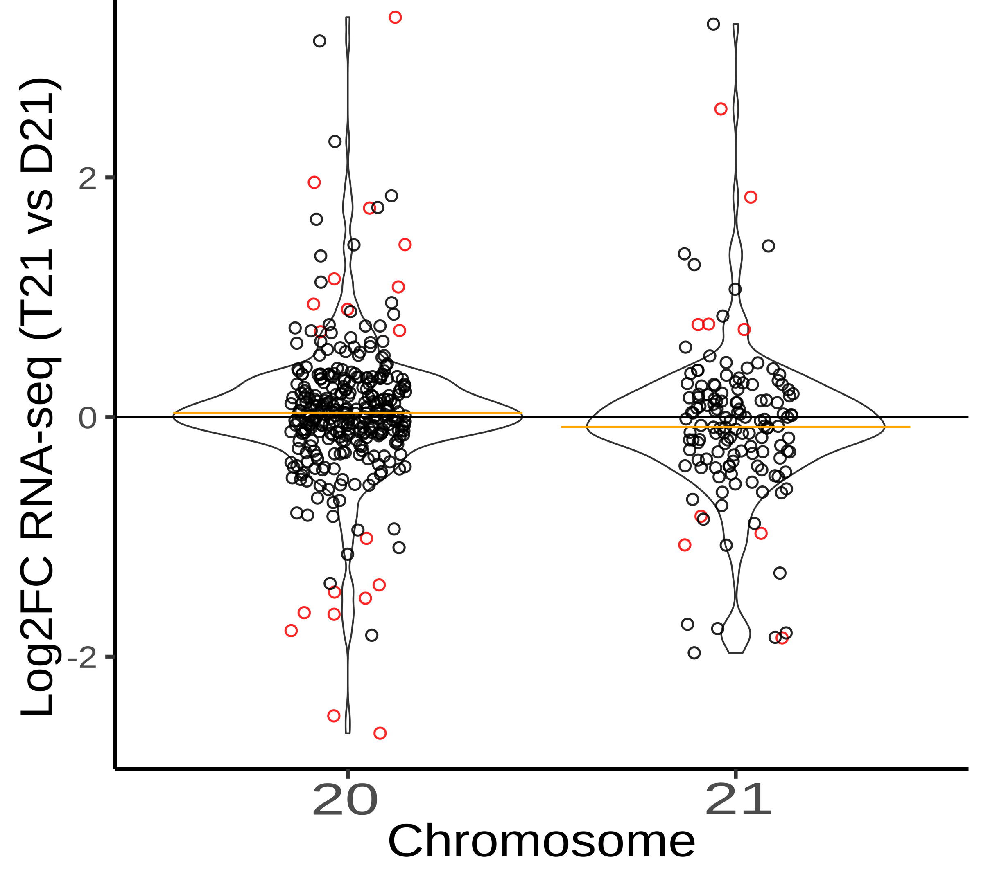
Reframing the Hypothesis:
Divide Reads By Ploidy
H0: FC = 1.0
HA: FC =/= 1.0
H0: FC = 1.0
HA: FC =/= 1.0
H0: abs(LFC) >= log2(1.5)
HA: abs(LFC) < log2(1.5)
Significant genes are those which are different than D21 expression levels
Significant genes are those whose average expression per copy is different
Significant genes are those which are expressed below expectation (1.5)

Slide 10
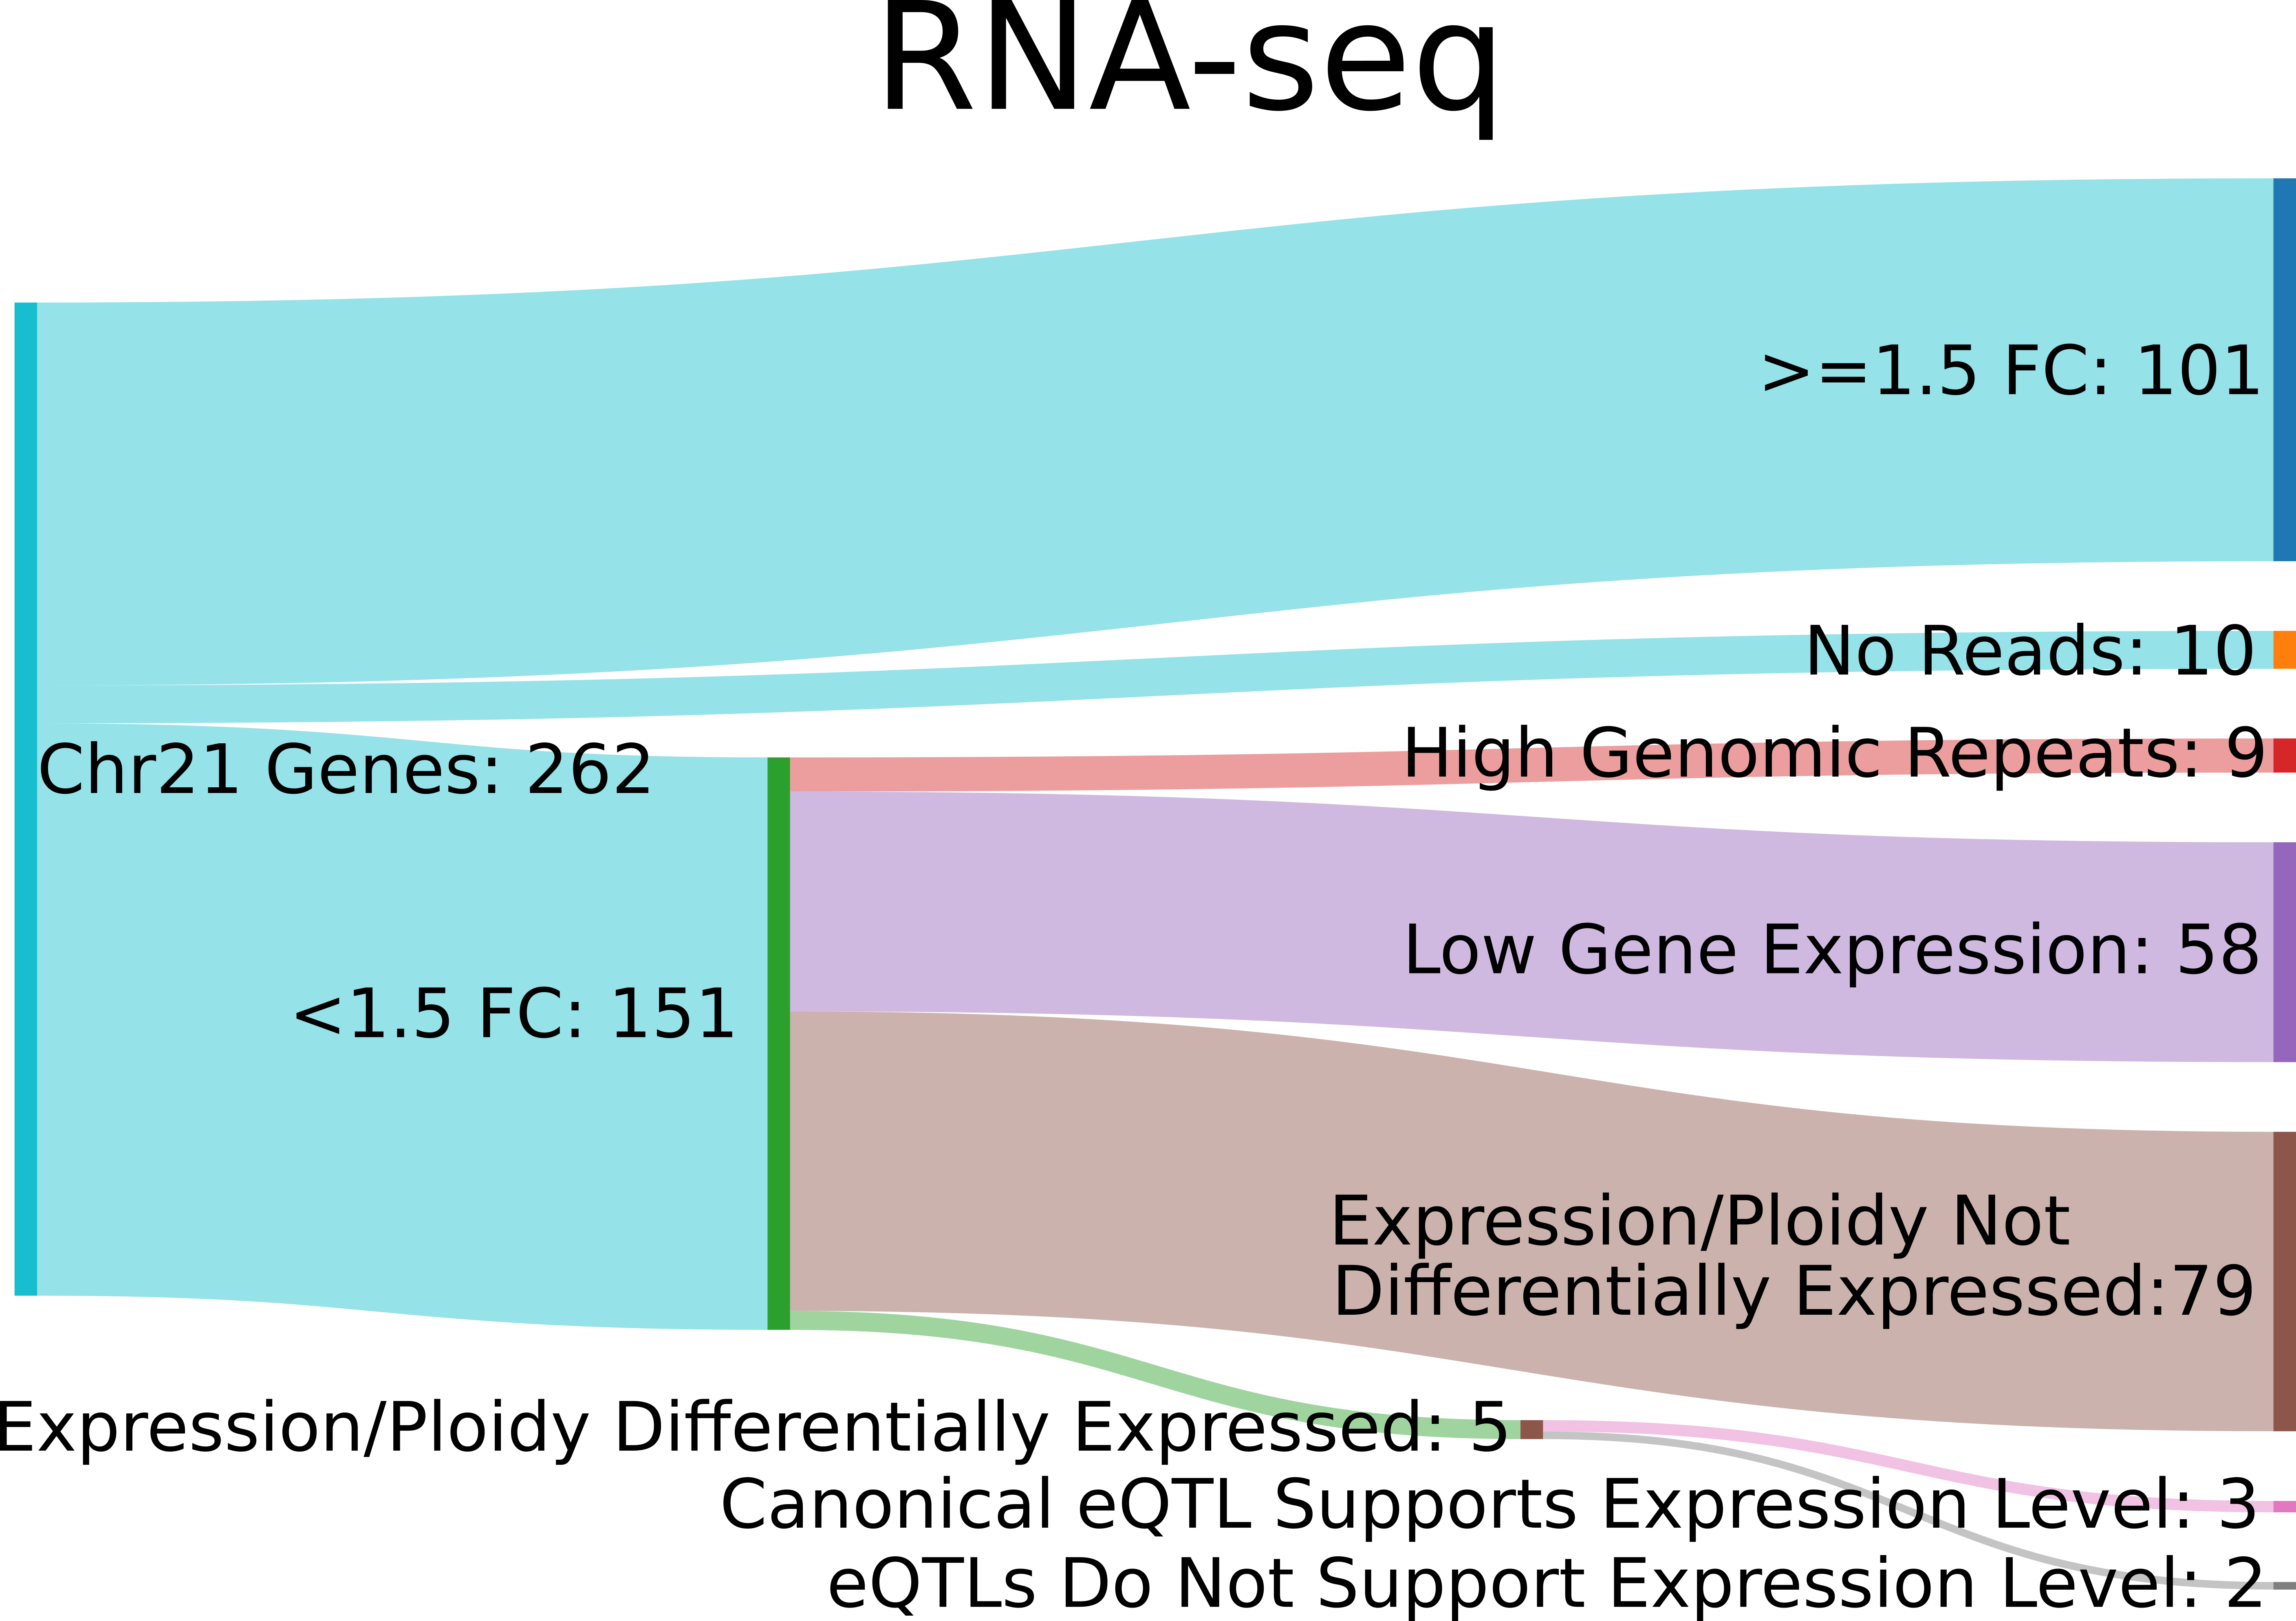

Slide 11
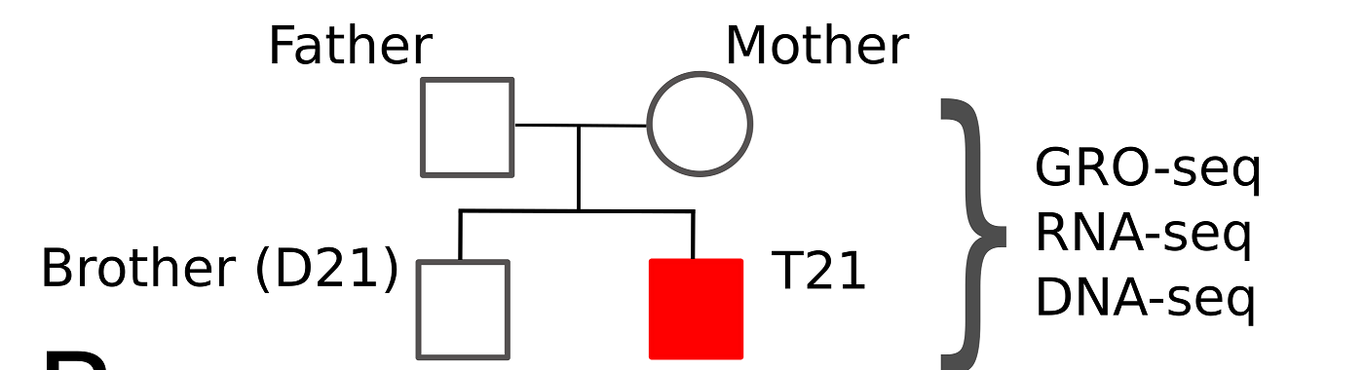
Determining dosage compensation through two approaches: biological and simulated datasets designed to have no compensation
Notes:
BAD! This is in the paper, but it’s unnecessary.

Slide 12
Naïve analysis of real data suggests fold change are slightly below expectation. Chromosome 21 genes are not consistently called as significant, and some chr21 genes fall below a LFC of 0
Notes:
Basically just show the before/after for GRO-seq next to the pipeline. Say you did a bunch of things, and found only a handful of DC genes

Slide 13
*Low quality reads contribute to false positives in dosage compensation calls
*In trisomy, read counts must be adjusted by ploidy number
*Higher variance leads to lower fold change calculations
*The proper null/adjusted hypotheses are not utilized by default

Slide 14
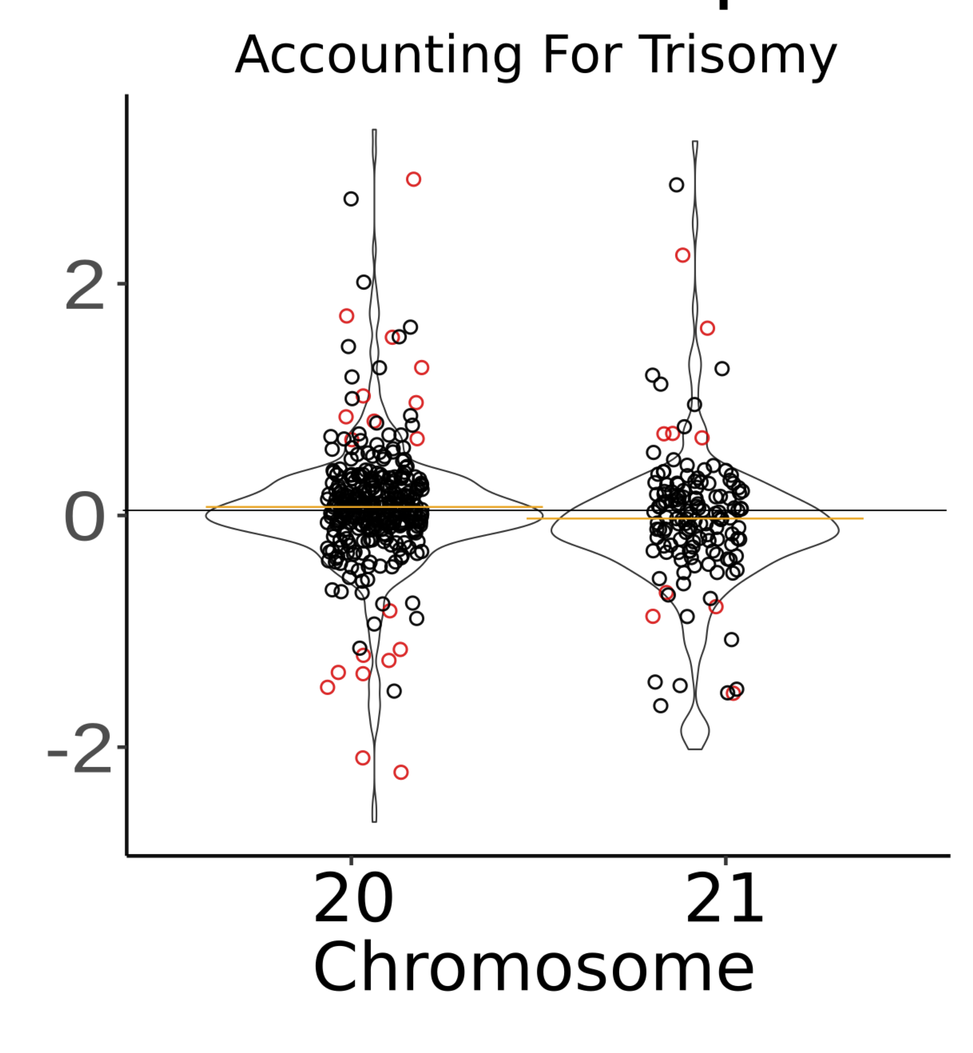
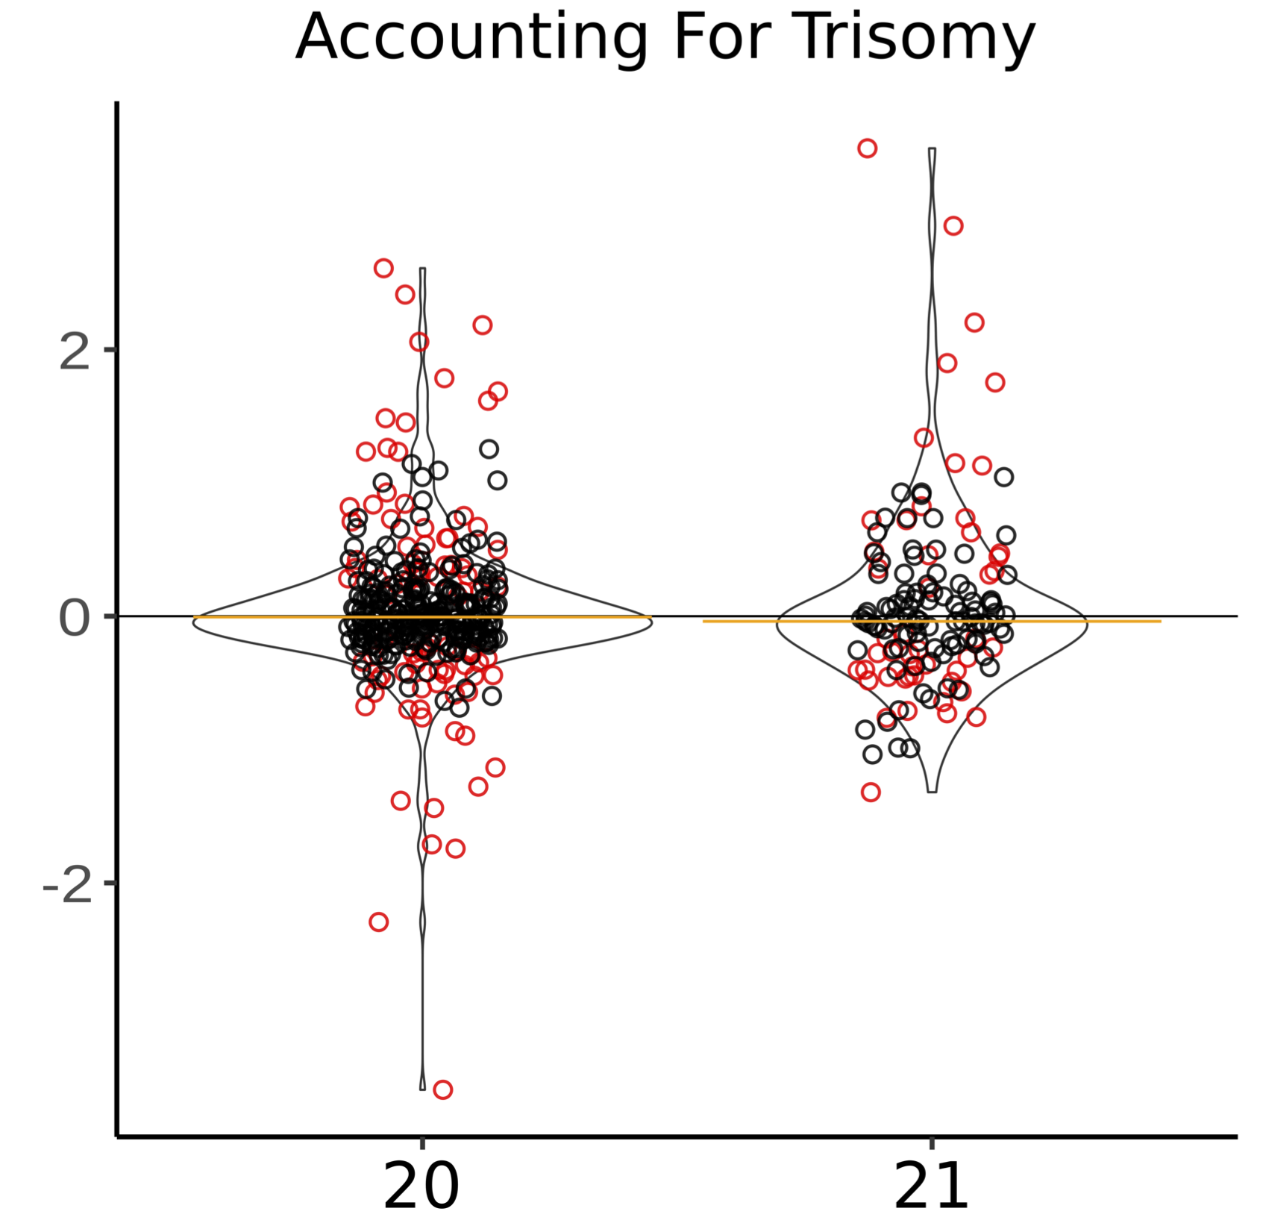
Log2FC(T21/D21)
Log2FC(T21/D21)
Chromosome

Slide 15
SNPs in eQTLs explain leftover “dosage compensated genes”
Notes:
Keep this slide, but really delve into it. This is the surprising result. Talk a lot about how eQTLs are the only real driver of leftover expression things

Slide 16
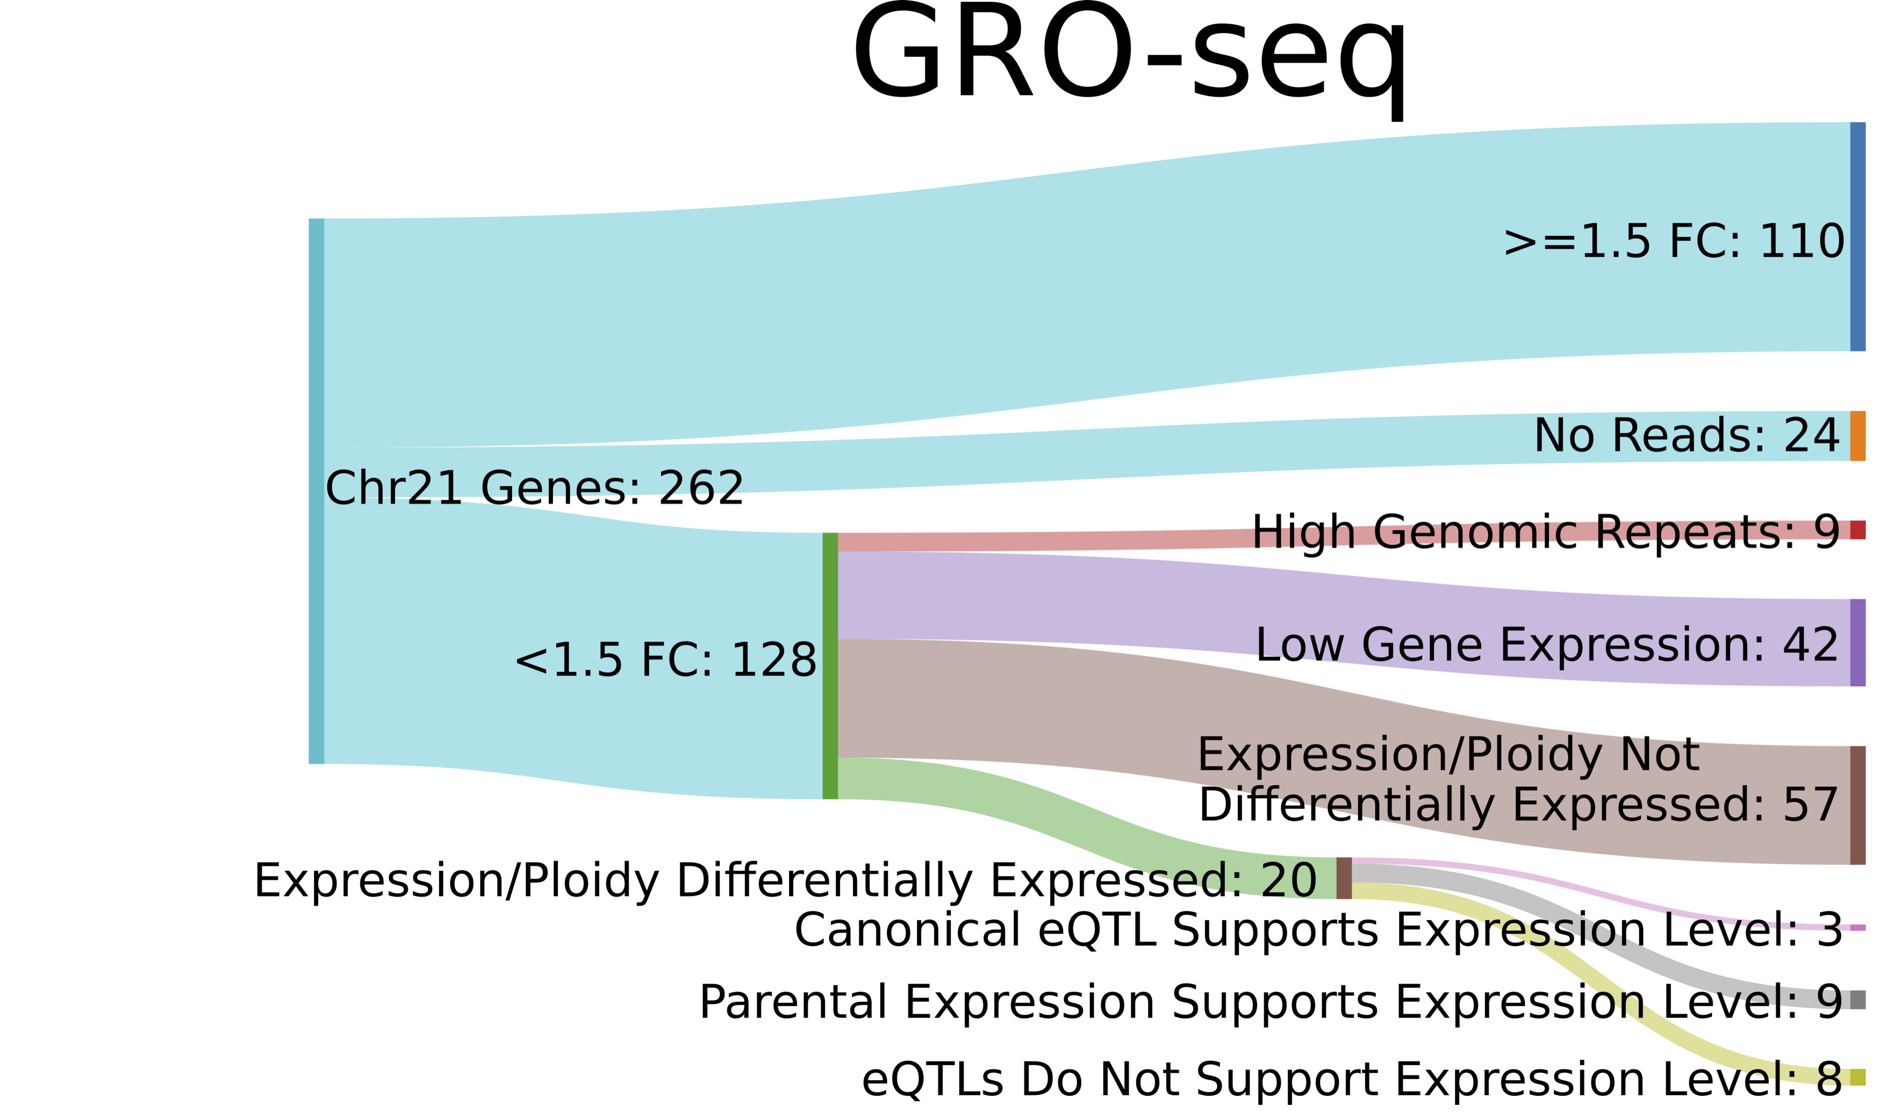
Conclusion: Dosage compensation does not occur in transcription regulation in trisomy
Notes:
Keep this slide, but really delve into it. This is the surprising result. Talk a lot about how eQTLs are the only real driver of leftover expression things

